Slide 1
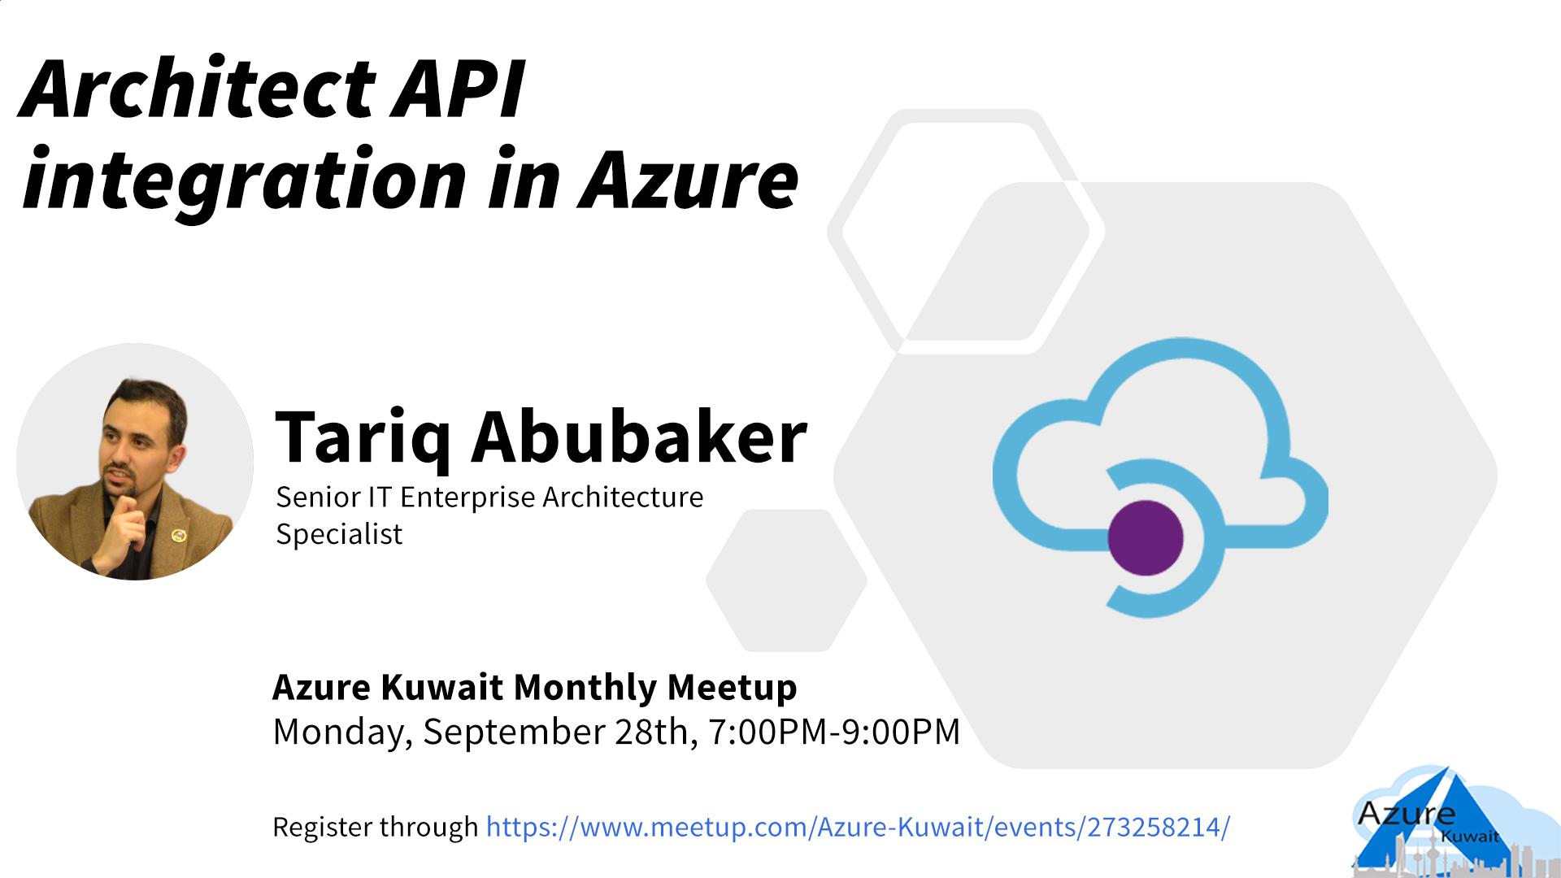

Slide 2

Architect API integration in Azure
By: Tariq Abubaker

Slide 3
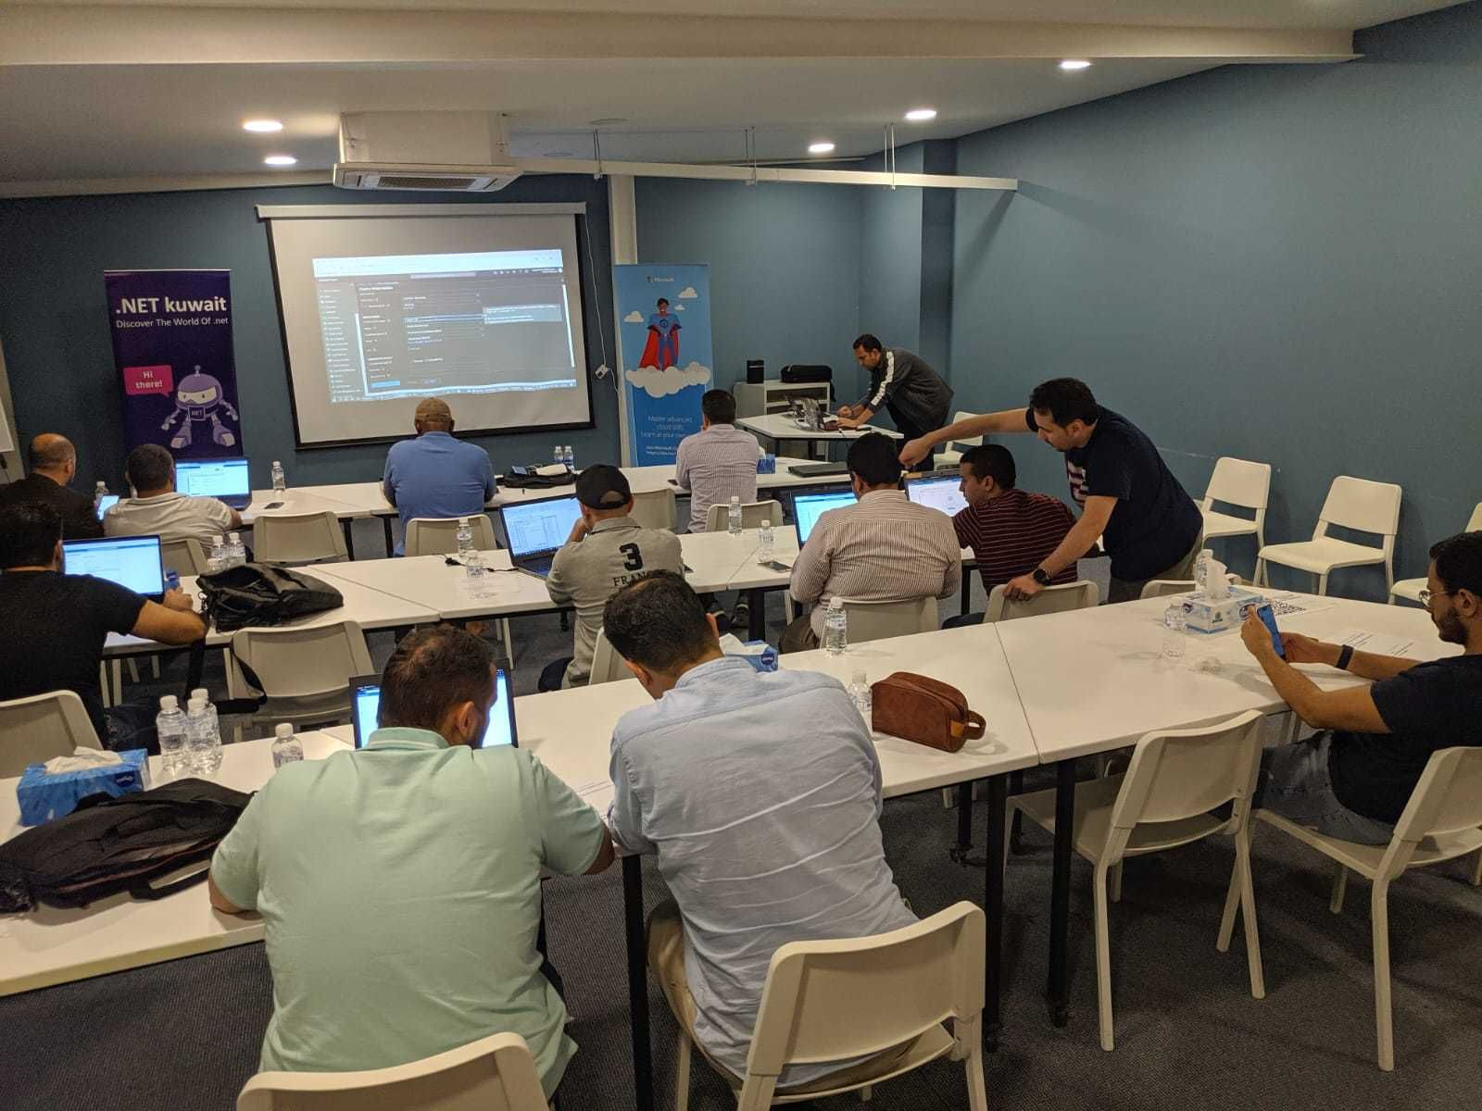
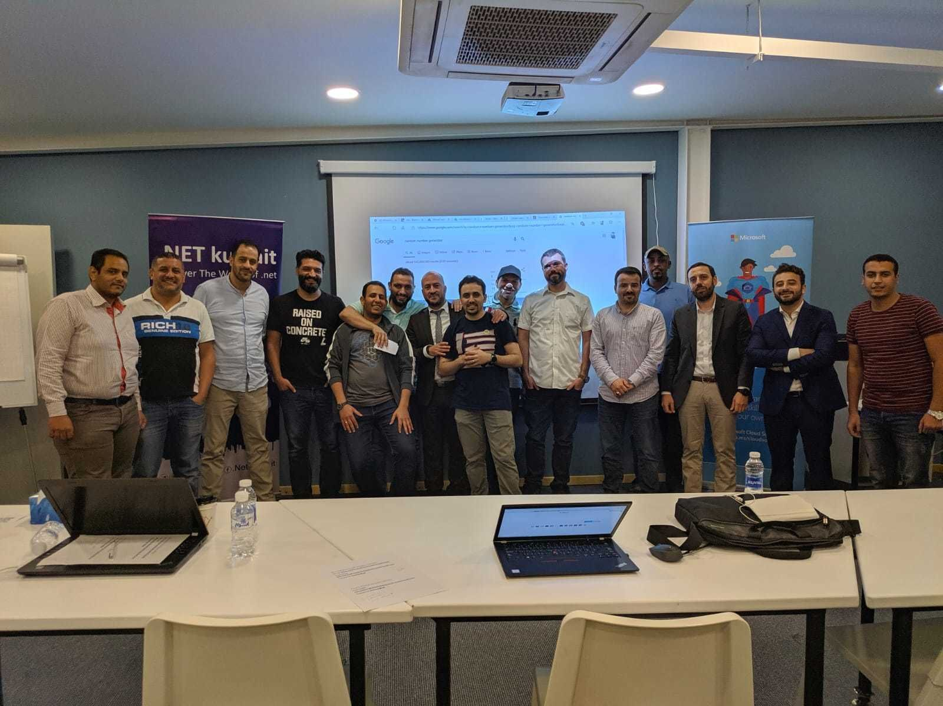
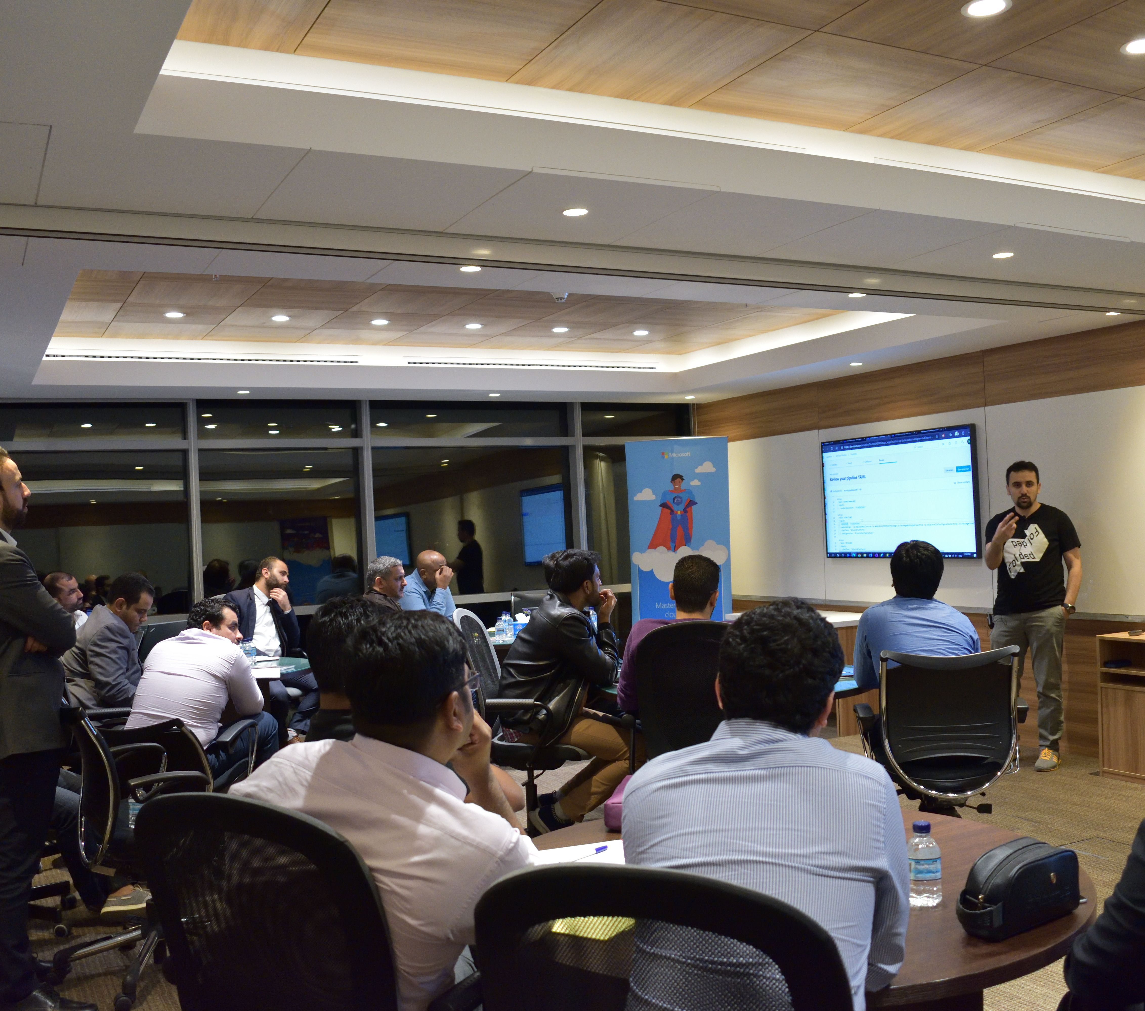
Azure Kuwait – Who are we?
Azure Kuwait is a community group to gather developers, technology enthusiasts from around Kuwait who are interested in Azure, .NET Core, Blazor, Open Source, Containerization, new technologies, etc to share experience, technology passion, learn from others, and have fun.

Slide 4
Azure Kuwait – What has been achieved so far?
July
2019
September
2019
Azure Tech Communities
370+
Members
10 Meetups

Slide 5



Tariq Abubaker
Overview
IT Enterprise Architect for Kuwait Finance House.
+10 years of experience in the IT and banking industry. I participated multiple projects range from SOA, EA, Core banking, Payment Solutions, Credit Cards, AML and Fraud, CRM, Retail, Finance, and IT service management solutions.
Azure Hero (Content and Community) badges holder.
Certifications
TOGAF® 9 Certified.
Azure Architect Expert Certified.
DevOps Certified.
ICAgile Certified Professional (ICP).
MCTS & MCP.
Contact Details
https://www.linkedin.com/in/tariq-abubaker/
@taq_abubaker

Slide 6

Amir Ismail
Overview
Senior Software Engineer for Kuwait Oil Company.
+15 years of experience in Software Engineering. I participated in multiple projects in different business domains range from E-learning, Banking, Oil, E-booing and Hotels management.
Certifications
PSM I Certified.
ITIL® Certified.
PRINCE2® Certified.
Contact Details
https://www.linkedin.com/in/amirismailyousef/

Slide 7
The Old Way of Building Products
Product 1
Product 2
Product 3
Product N
…
Reference: Microsoft Ignite 2017 - Azure API Management: Why, what, how, and what’s next - BRK2186

Slide 8
The Modern Way of Building Products
Product 1
Product 2
Product 3
Product N
…
API Catalog
Reference: Microsoft Ignite 2017 - Azure API Management: Why, what, how, and what’s next - BRK2186

Slide 9
Challenges
Discoverability
What APIs are available and what do they do?
Onboarding
How can consumers request access to APIs and learn how to use them?
Security
How do I secure my vital data?
How do I protect my backends from unauthorized access and overload?
Monitoring
Lifecycle
Who is using my APIs and how much?
Are my APIs online and working as expected?
How do I evolve my APIs without adversely impacting consumers?

Slide 10








Solve the challenge with API Management
Product 1
Product 2
Product 3
Product N
…
API Management
Backend on Azure
Backend on Premises
Reference: Microsoft Ignite 2017 - Azure API Management: Why, what, how, and what’s next - BRK2186

Slide 11
What is an API Management?
API Management (APIM) is a way to create consistent and modern API gateways for existing back-end services. It helps organizations publish APIs to external, partner, and internal developers to unlock the potential of their data and services in a reliable, scalable, and secure way.
11

Slide 12

API Management Benefits
API Documentation
Rate Limiting Access
Health Monitoring
Connections to any API
Analytics
Security
Modern Formats like JSON

Slide 13





API Management - a hub for enterprise APIs
1st and 3rd party apps
Abstract
Secure & protect
Evolve
Monitor
Analyze
Productize
Monetize
Discover
Learn
On-board
Try
Get support
SDKs and samples
Consume
Mediate
Publish
Developer portal
Gateway
Azure portal
API managers and developers
App developers
APIs on Azure and outside
13
Reference: Microsoft Ignite 2017 - Azure API Management: Why, what, how, and what’s next - BRK2186

Slide 14
Demo

Slide 15
What is a breaking change?
Version or not?
Versioning!!!
🤔
Semantic versioning?
How to identify version?
Number? Date? Name?
Where to place version information?
Path? Query? Header? Media type?
Reference: Microsoft Ignite 2017 - Azure API Management: Why, what, how, and what’s next - BRK2186

Slide 16
API Management Approach for Versioning
Revisions
Natively understand versions at the system level
Versioning is an opt-in
Offer versioning scheme options
Inform developers about the changes
Control when the changes get adopted
Providers choose when to deploy
Versions
Consumers choose when to adopt
Reference: Microsoft Ignite 2017 - Azure API Management: Why, what, how, and what’s next - BRK2186

Slide 17
Versions and revisions in API Management
Service Instance
API
Version
Revision
Operation
/v1
;rev=1
;rev=2
;rev=3
/speakers
/sessions
/days
https://example.org/
foo
;rev=4
/v2
;rev=1
;rev=2
Reference: Microsoft Ignite 2017 - Azure API Management: Why, what, how, and what’s next - BRK2186

Slide 18
Demo

Slide 19
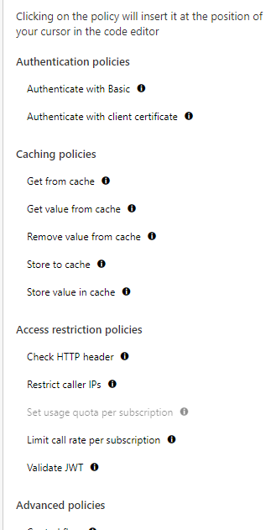
API Management Policies
Encapsulate common API management functions
Access control, Protection, Transformation, Caching, …
Chained together into a pipeline
Mutate request context or change API behavior
Set in the inbound and outbound directions
Can be triggered on error
Applied at a variety of scopes
19
Reference: Microsoft Ignite 2017 - Azure API Management: Why, what, how, and what’s next - BRK2186

Slide 20
Policy Scopes
GET /foo/bar HTTP/1.1
Host: api.constoso.com
Key: 0123456789
global
CORS
LOG
0123456789
product
from caller
RATE
QUOTA
inbound
to backend
/foo
api
JWT
/bar
operation
CACHE
URL
BODY
to caller
from backend
outbound
20
Reference: Microsoft Ignite 2017 - Azure API Management: Why, what, how, and what’s next - BRK2186

Slide 21
Policy Expression
Policies are formed of individual statements, which are executed in order. The policy documents are XML structures, which contain elements that you can use to control the behavior of the API.
<policies>
<inbound>
<base />
<check-header name="Authorization" failed-check-httpcode="401" failed-check-error-message="Not authorized" ignore-case="false">
</check-header>
</inbound>
<backend>
<base />
</backend>
<outbound>
<base />
<json-to-xml apply="always" consider-accept-header="false" parse-date="false" />
</outbound>
<on-error>
<base />
</on-error>
</policies>

Slide 22
Demo

Slide 23
Policies can do more!
Organizations that publish web APIs often need to control the behavior of those APIs without recoding them.
API Management Policies help you to:
Remove unnecessary technical information from API responses to prevent malicious attacks.
Mask URLs.
Throttle API requests to prevent abuse of the APIs.

Slide 24
Demo

Slide 25
Security and Protection
Username/Password
Microsoft account
Google account
Facebook account
Twitter account
Azure AD (Premium)
Azure AD B2C (Premium)
Delegated
Developer portal
Consume
App developers
Key
OAuth 2
OpenID Connect
Client certificate
IP filter
Rate limits and quotas
Gateway
HTTP Basic
Mutual certificate
Shared secret
IP filter
VNET/NSG
Mediate
1st and 3rd party apps
Azure portal
Azure account
RBAC
Publish
APIs on Azure and outside
API managers and developers
25
Reference: Microsoft Ignite 2017 - Azure API Management: Why, what, how, and what’s next - BRK2186

Slide 26
Demo

Slide 27





VNETs and Hybrid
Developer portal
Consume
App developers
VNET
Gateway
Mediate
1st and 3rd party apps
Azure portal
Publish
APIs on Azure and outside
API managers and developers
Reference: Microsoft Ignite 2017 - Azure API Management: Why, what, how, and what’s next - BRK2186

Slide 28



VNETs and Hybrid
VPN
VNET
Gateway
Mediate
1st and 3rd party apps
Reference: Microsoft Ignite 2017 - Azure API Management: Why, what, how, and what’s next - BRK2186

Slide 29

Multi-Region and Scaling
North Europe
Standard
1 unit
Reference: Microsoft Ignite 2017 - Azure API Management: Why, what, how, and what’s next - BRK2186

Slide 30
Multi-Region and Scaling
North Europe
Standard
1 unit
3 units
Reference: Microsoft Ignite 2017 - Azure API Management: Why, what, how, and what’s next - BRK2186

Slide 31
Multi-Region and Scaling
Central US
North Europe
1 unit
remote
Standard
Premium
1 unit
home
3 units
Native integration!
Reference: Microsoft Ignite 2017 - Azure API Management: Why, what, how, and what’s next - BRK2186

Slide 32
Multi-Region and Scaling
Central US
North Europe
2 units
remote
Premium
1 unit
remote
1 unit
home
Native integration!
Reference: Microsoft Ignite 2017 - Azure API Management: Why, what, how, and what’s next - BRK2186

Slide 33
Azure API Management
Cloud hosted, turnkey, fully managed
Works with APIs running in the cloud or on-prem
Abstracts, protects and optimizes APIs
Promotes and supports app developer engagement
Provides API governance, insights, and analytics
Reference: Microsoft Ignite 2017 - Azure API Management: Why, what, how, and what’s next - BRK2186

Slide 34


Contact Us
@azure_q8
@azure_q8

Slide 35

SCAN THE CODE & START YOUR Migration today
https://aka.ms/AA6923d
35

Slide 36
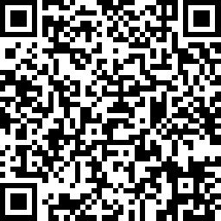
SCAN THE CODE & SEND US YOUR FEEDBACK!
https://www.surveymonkey.com/r/YKB8QN9
36

Slide 37
Resources
https://channel9.msdn.com/events/Ignite/Microsoft-Ignite-Orlando-2017/BRK2186?term=BRK2186&lang-en=true
https://docs.microsoft.com/en-us/learn/paths/architect-api-integration/

Slide 38
Q&A Thank You!

